Slide 1
The Domain Name System (DNS)

Slide 2
Ports and Sockets (1 of 2)
A port is a number assigned to a process that can receive data
Port numbers ensure data is transmitted to the correct process among multiple processes running on a single device
A socket consists of host’s IP address and the port number of an application running on the host
A colon separates the two values
Example - 10.43.3.87:23
Port numbers are divided into three types:
Well-known ports - 0 to 1023
Registered ports - 1024 to 49151
Dynamic and private ports - 49152 to 65535

Slide 3
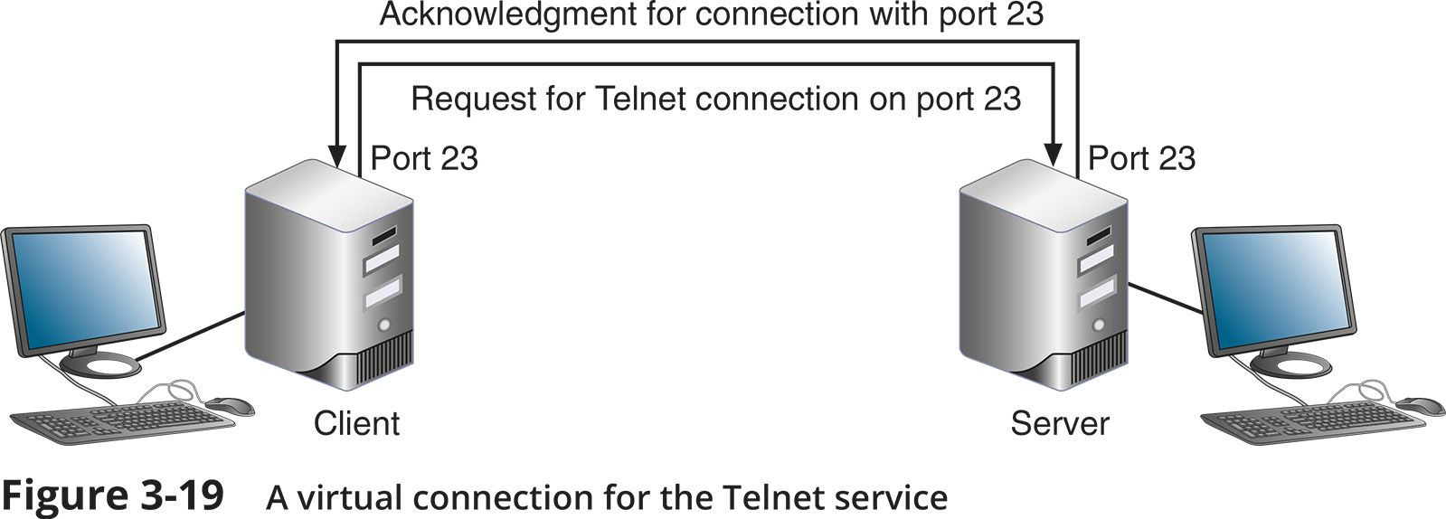
Ports and Sockets (2 of 2)

Slide 4
Domain Names and DNS (1 of 2)
Character-based names are easier to remember than numeric IP addresses
A URL (uniform resource locator) is an addressing scheme that identifies where to find a particular resource on a network
Last part of an FQDN is called the top-level domain (TLD)
Domain names must be registered with an Internet naming authority that works on behalf of ICANN
ICANN restricts what type of hosts can be associated with .arpa, .mil, .int, .edu, and .gov
Name resolution is the process of discovering the IP address of a host when you know the FQDN

Slide 5
Domain Names and DNS (2 of 2)
DNS is an Application layer client-server system of computers and databases made up of these elements:
Namespace - the entire collection of computer names and their associated IP addresses stored in databases on DNS name servers around the globe
Name servers - hold databases, which are organised in a hierarchical structure
Resolvers - a DNS client that requests information from DNS name servers

Slide 6
Namespace Databases
Each organisation that provides host services is responsible for providing and maintaining its own DNS authoritative servers for public access
An authoritative name server is the authority on computer names and their IP addresses for computers in their domains
The domains that the organisation is responsible for managing are called a DNS zone

Slide 7
Name Servers (1 of 4)
Four common types of DNS servers:
Primary DNS server – the authoritative name server for the organisation
Holds the authoritative DNS database for the organisation’s zones
Secondary DNS server – backup authoritative name server for the organisation
Caching DNS server – accesses the public DNS data and caches the DNS information it collects
Forwarding DNS server – receives queries from local clients but doesn’t work to resolve the queries

Slide 8
Name Servers (1 of 4)
Any of these DNS server types can co-exist on the same machine
DNS name servers are organised in a hierarchical structure
At the root level, 13 clusters of root DNS servers hold information used to locate top-level domain (TLD) servers

Slide 9
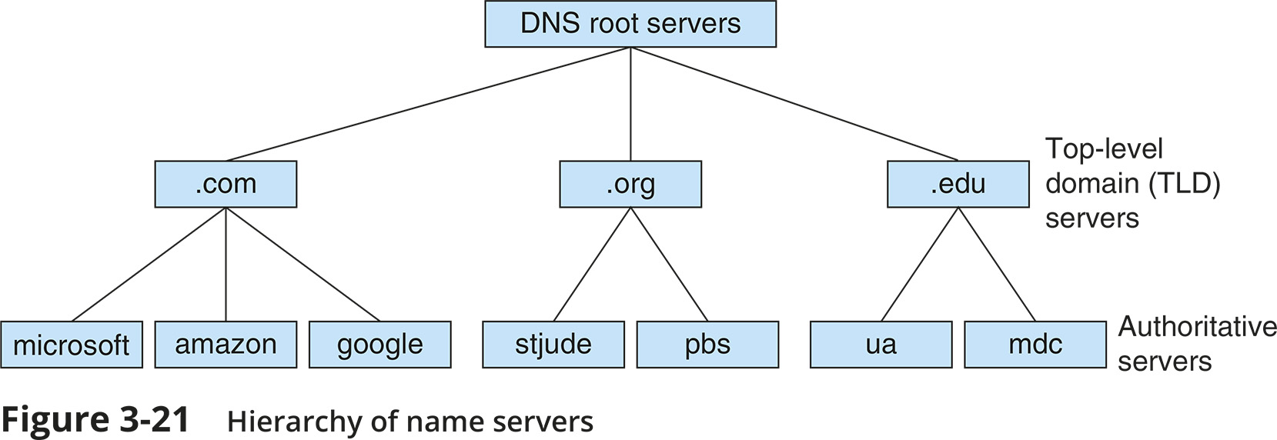
Name Servers (2 of 4)

Slide 10
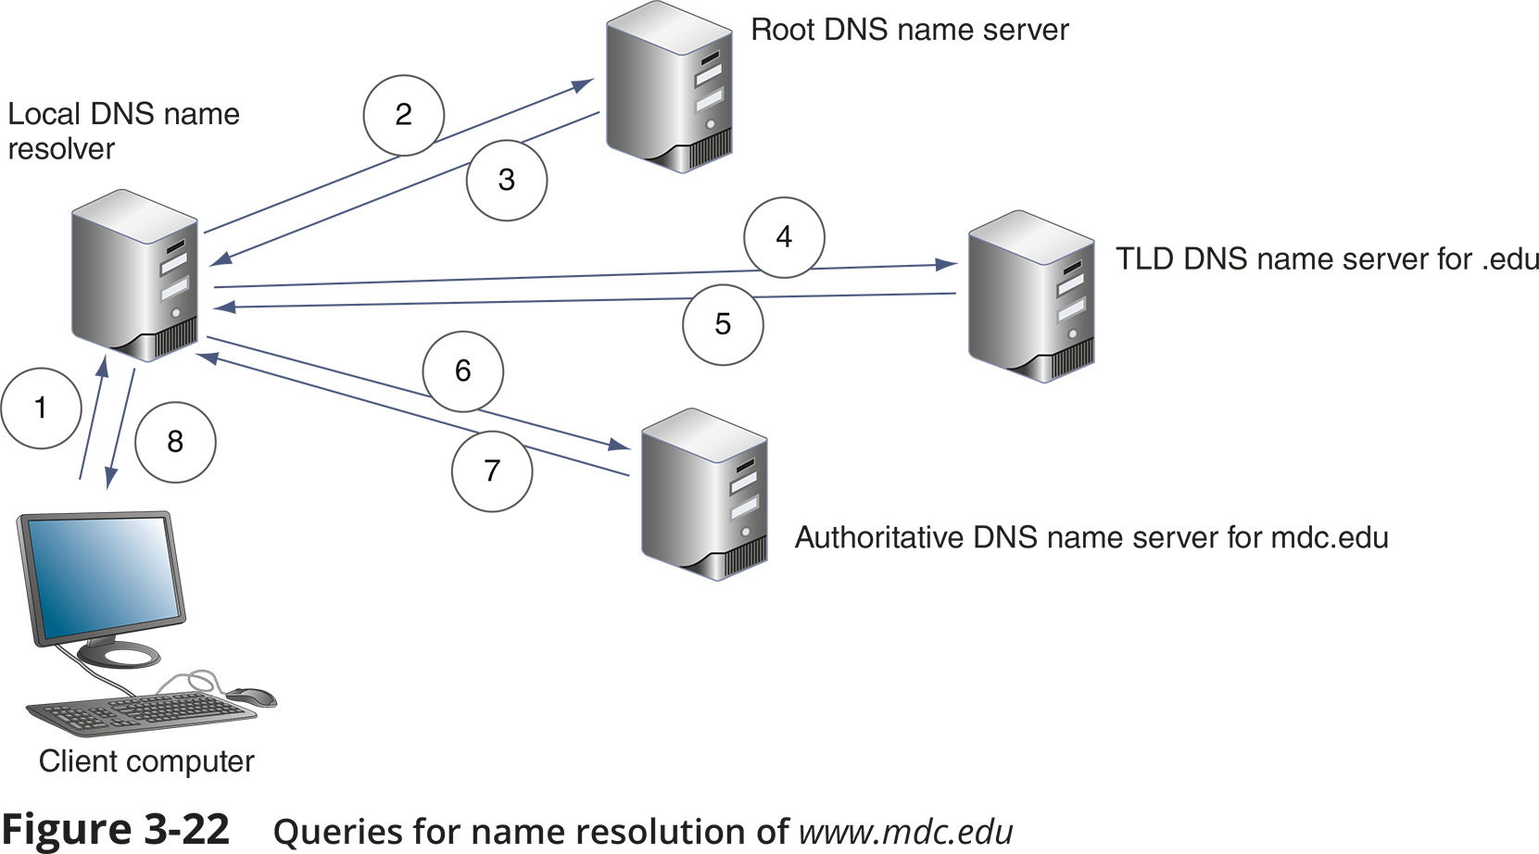
Name Servers (3 of 4)

Slide 11
Name Servers (4 of 4)
Ways the resolution process can get more complex:
A caching server typically is not the same machine as the authoritative server
The caching server exists only to resolve names for its own local clients
Name servers within a company might not have access to root servers
A TLD name server might be aware of an intermediate name server rather than the authoritative name server

Slide 12
Name Servers (4 of 4)
Two types of DNS requests:
Recursive lookup – a query that demands a resolution or the answer “It can’t be found”
Iterative lookup – a query where the local server issues queries to other servers
Other servers only provide information if they have it
Do not demand a resolution

Slide 13
Resource Records in a DNS Database
Several types of records, called resource records are kept in a DNS database:
SOA (start of authority) record – gives information about the zone
A (address) record – stores the name-to-address mapping for a host
AAAA (address) record – holds the name-to-address mapping, the IP address is an IPv6 type IP address
CNAME (canonical Name) record – holds alternative names for a host

Slide 14
Resource Records in a DNS Database
Several types of records, called resource records are kept in a DNS database:
PTR (pointer) record – used for reverse lookups
NS (name Server) record – indicates the authoritative name server for a domain
MX (mail exchanger) record – identifies a mail server and is used for email traffic
SRV (service) record – identifies the hostname and port of a computer that hosts a specific network services besides email
TXT (text) record – holds any type of free-form text

Slide 15
DNS Server Software
BIND (Berkeley Internet Name Domain) is the most popular DNS server software
Open source - the term for software whose code is publicly available for use and modification
Microsoft DNS Server is a built-in DNS service in the Windows Server OS
Windows Server is capable of split-brain or split-horizon deployment, which is used to handle internal clients and external clients

